Slide 1

3D Slicer 2-Day Workshop
The George Washington University
4/1 & 4/3

Slide 2
Learning Objectives
After this workshop you should be familiar with how to…
Import CT scans from image stacks
Visualize 3D data and generate graphics
Segment CT scans and generate models
Analyze and measure morphology
Use SlicerMorph for 3D geometric morphometrics
Utilize resources to keep learning about 3D Slicer

Slide 3
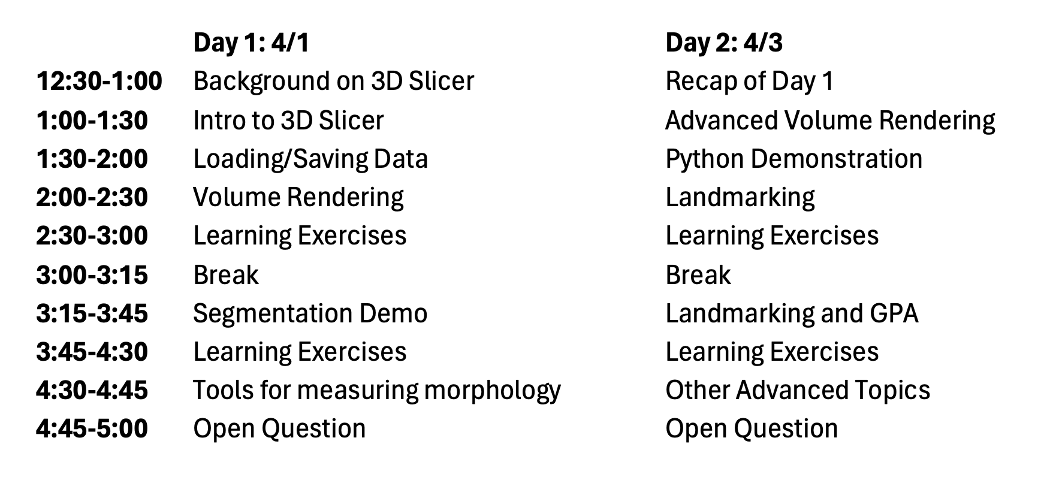
Schedule

Slide 4
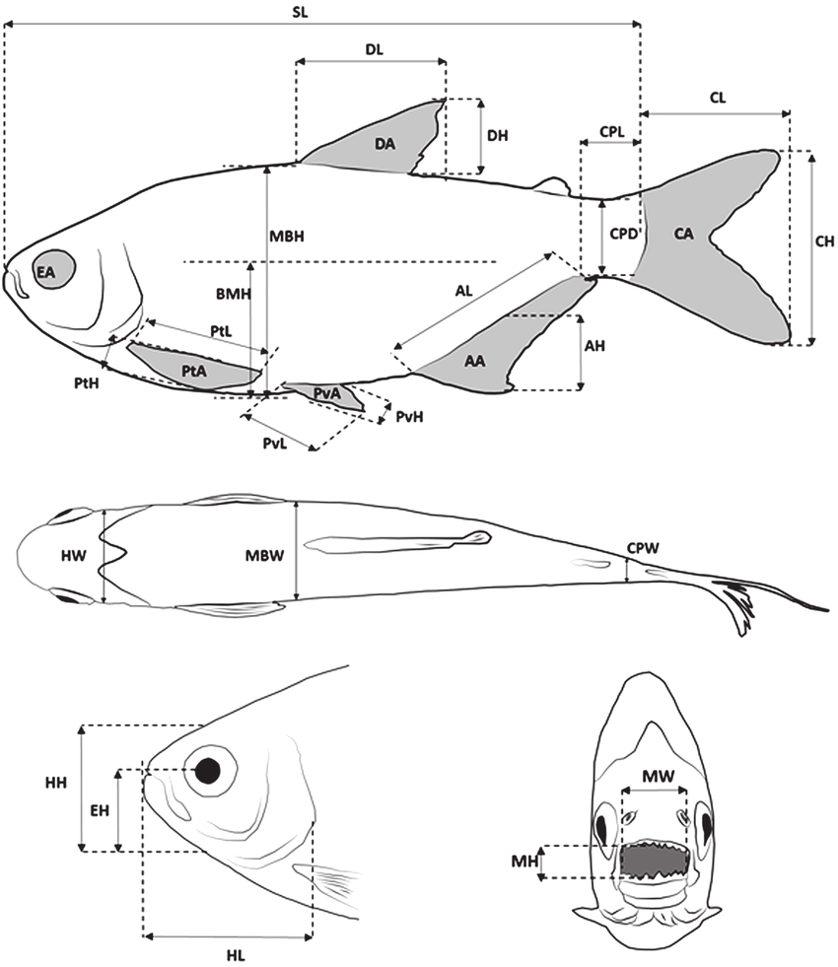
Traditional Linear Morphometrics
Traditional method of quantifying morphology
Easy to do
However, lacks spatial information regarding where traits are relative to one another (spatial distribution)
Conde-Saldana et al. 2017

Slide 5
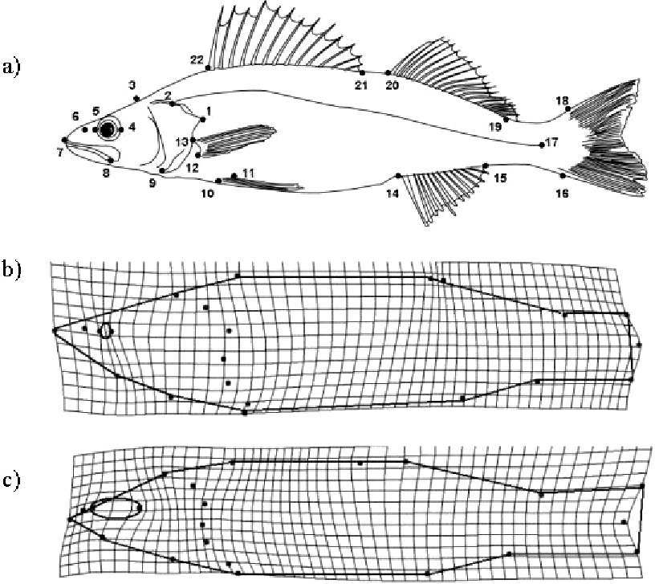
Geometric Morphometrics
Geometric Morphometrics – use of landmarks and their coordinates to compare biological form based on the relative position of the landmarks
Widely used
Limited by homology (kind of)
Limited statistical power (sometimes)
Moles et al 2010

Slide 6
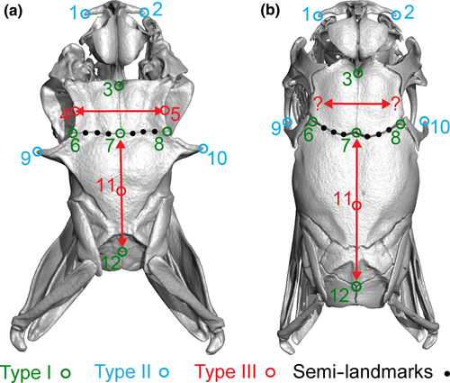
Types of Landmarks
Type I: juxtaposition of tissue or foramina
Type II: self-evident geometry (tips of processes or notches)
Type III: geometric construction (e.g., deepest point in the notch)
Semi-landmarks (typically equidistant along a curve)
Palci and Lee 2018

Slide 7
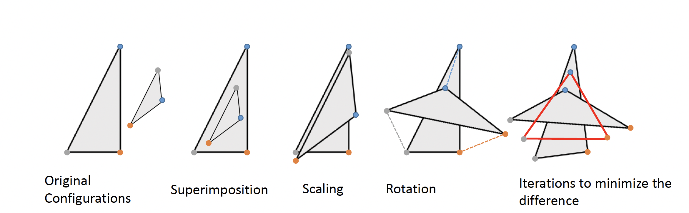
Generalized Procrustes Superimposition

Slide 8
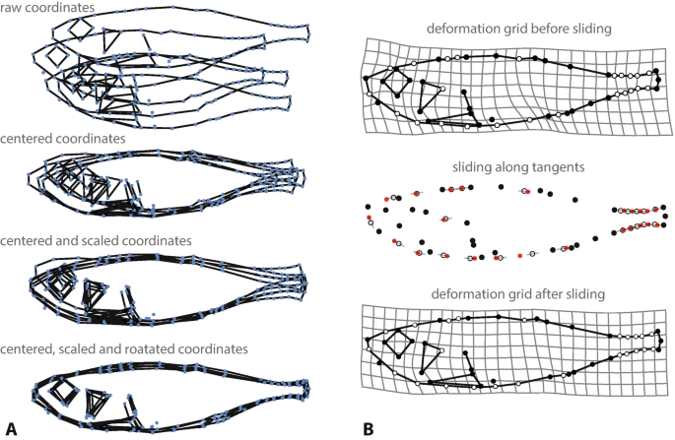
Mitteroecker 2021

Slide 9
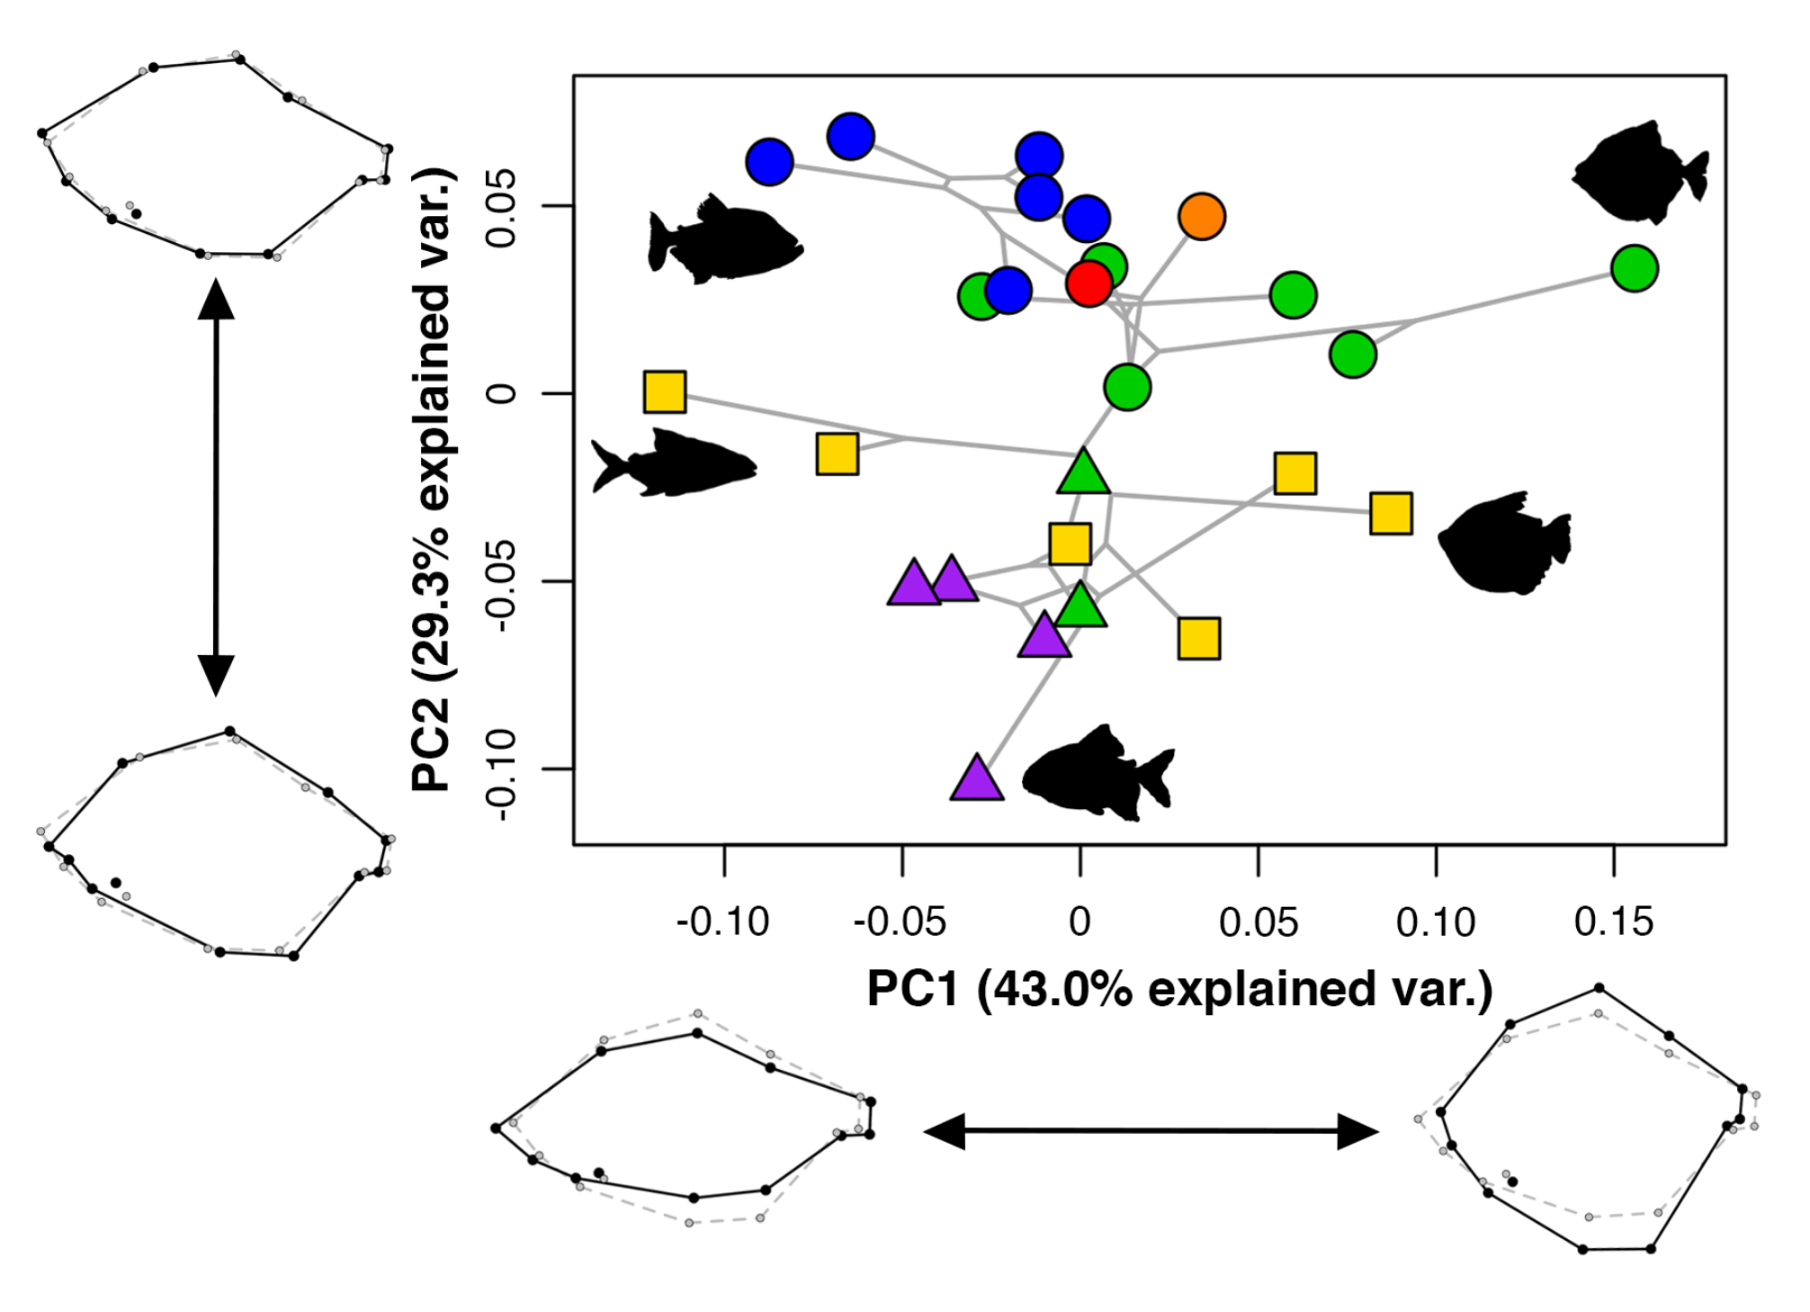
Huie et al. 2019

Slide 10
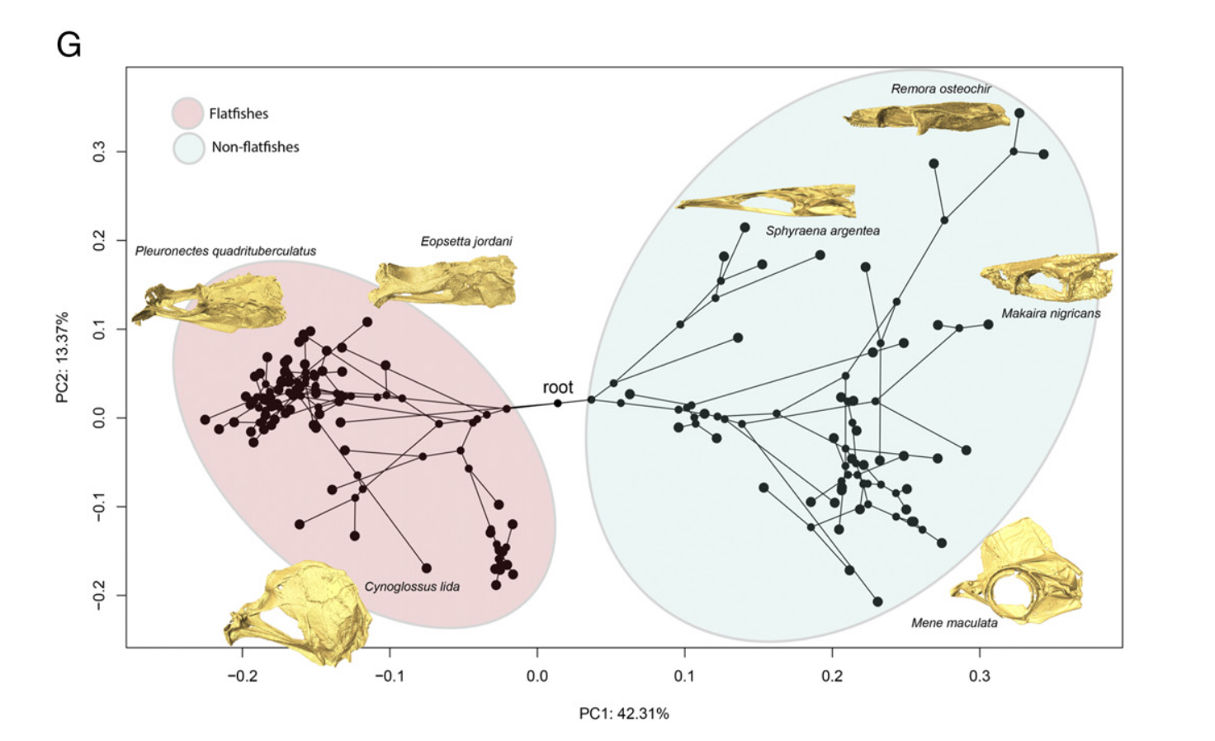
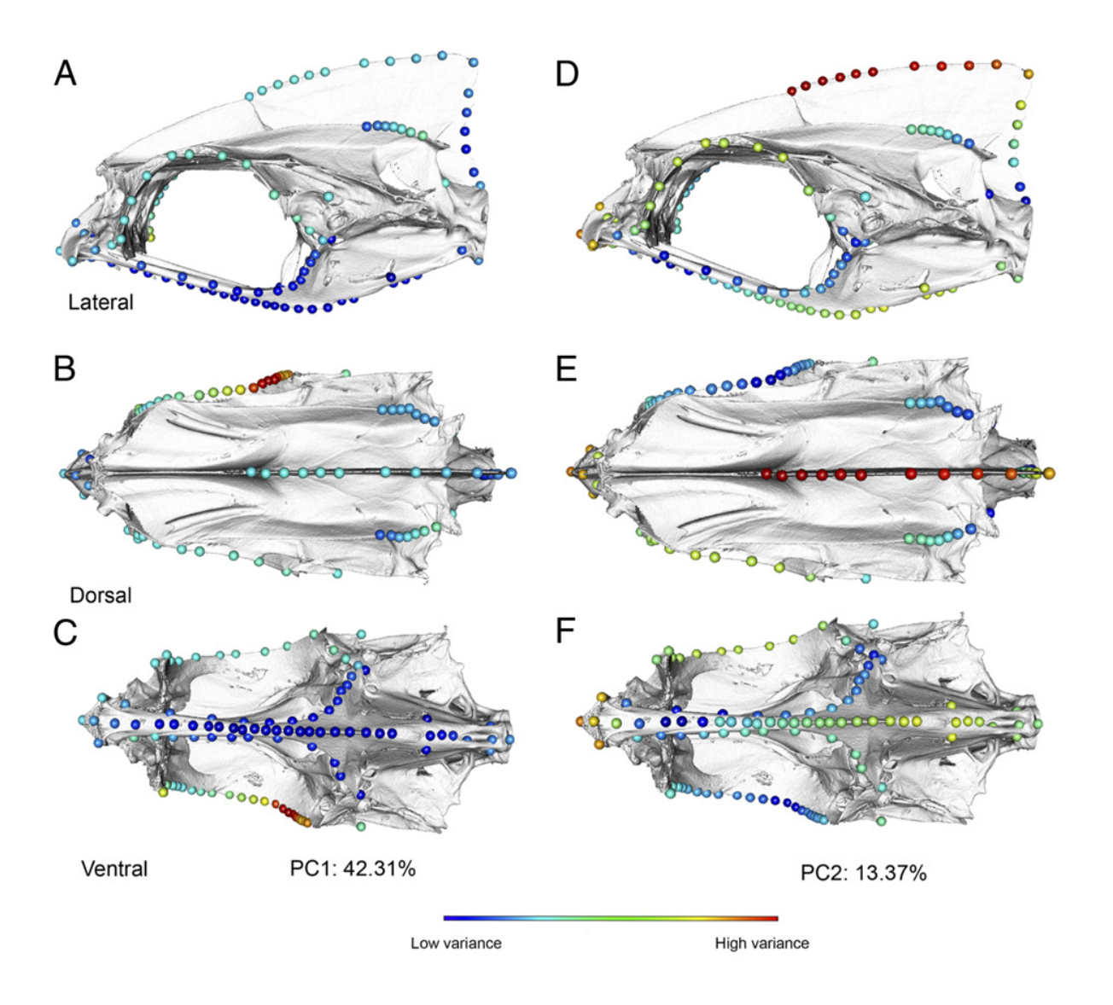
Evans et al. 2021

Slide 11
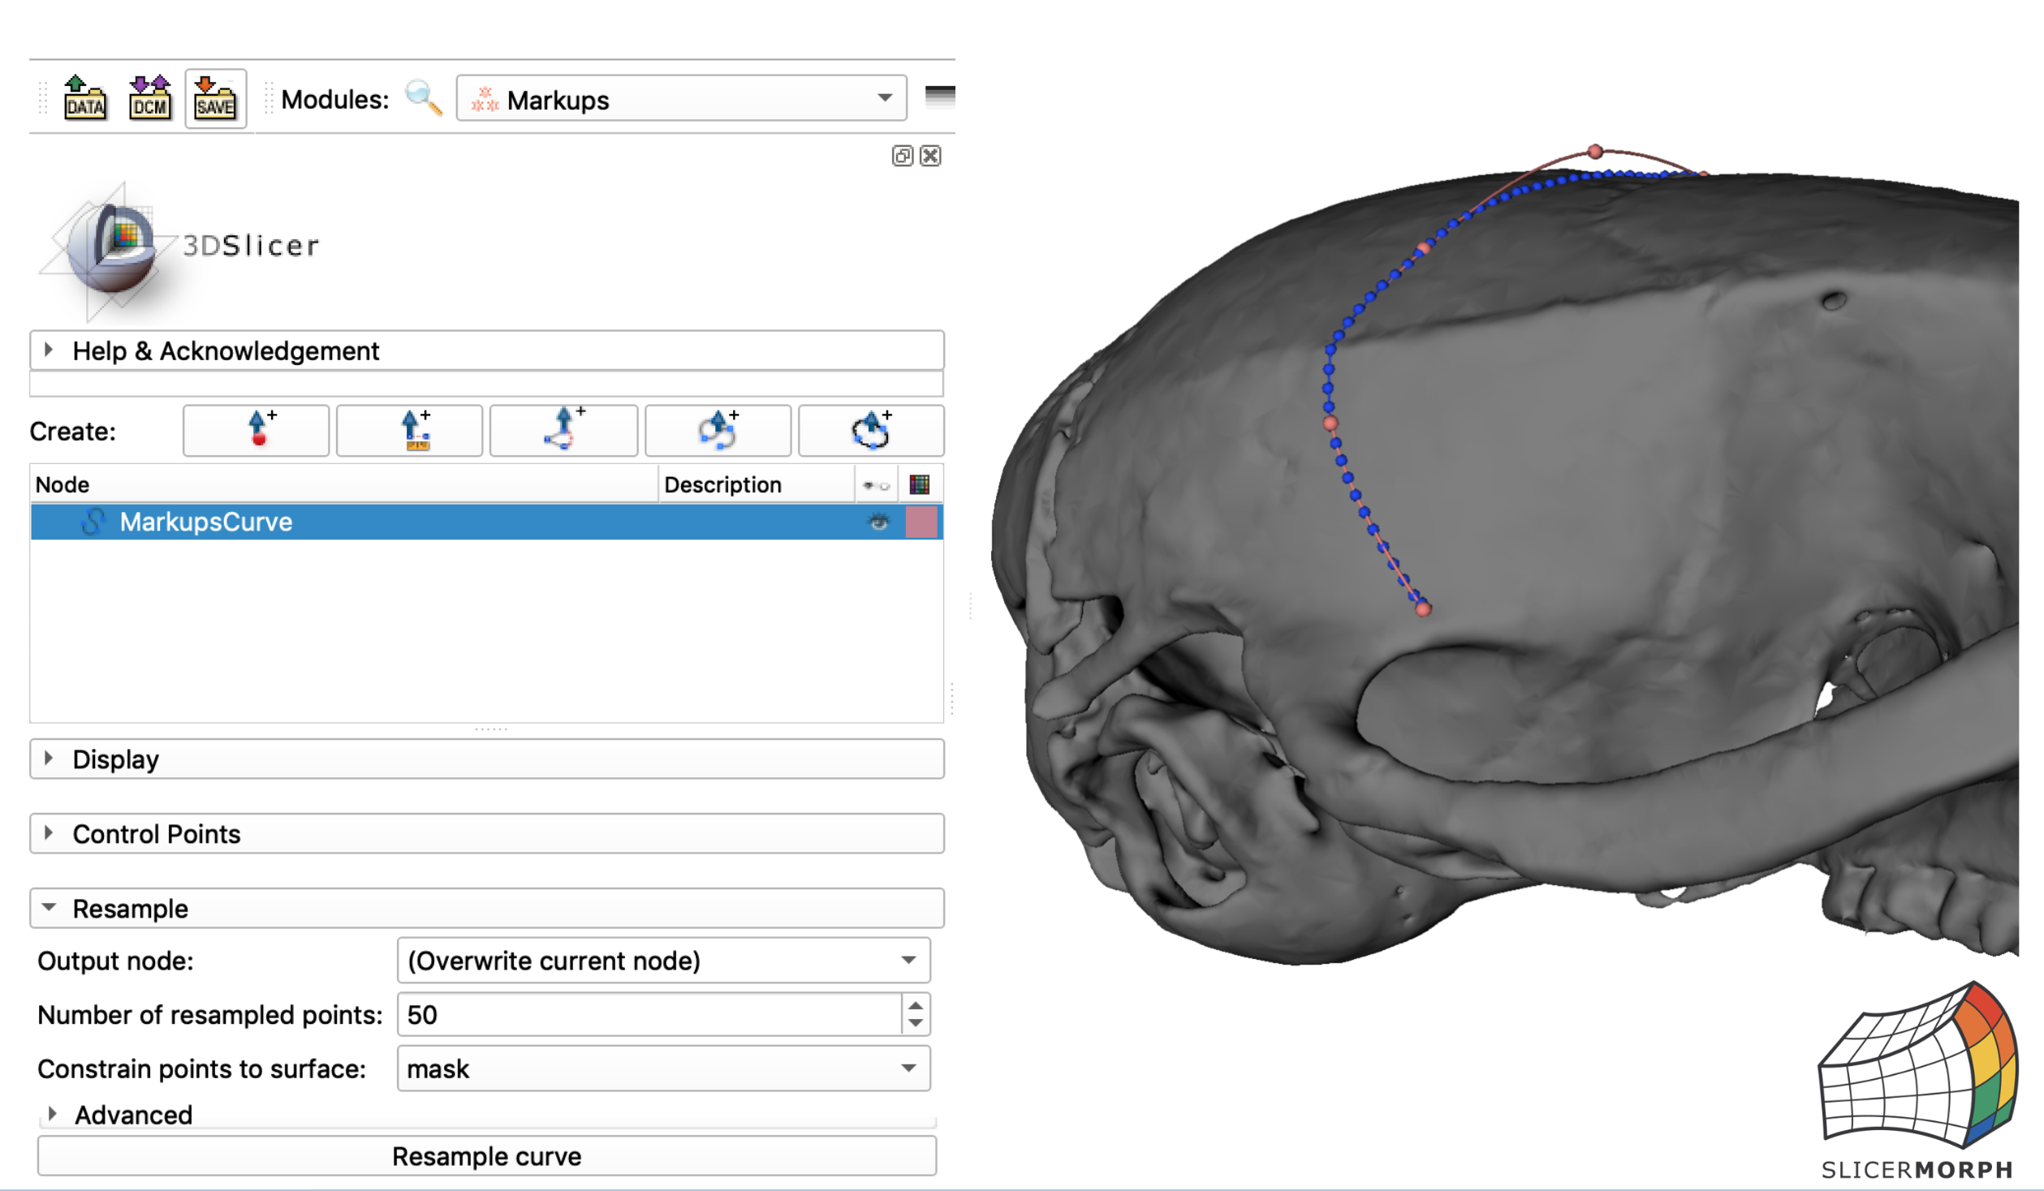
Semi-landmark curves

Slide 12
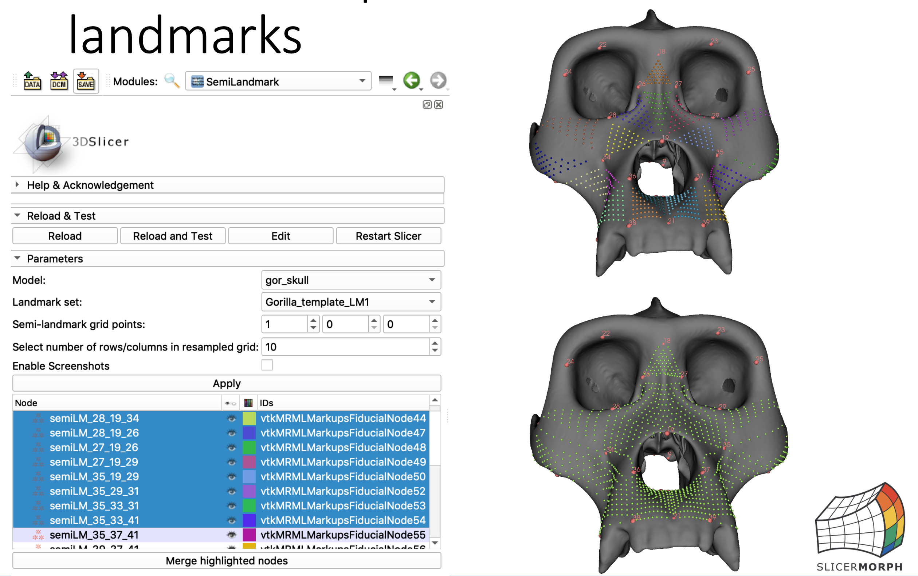
Patch based semilandmars

Slide 13
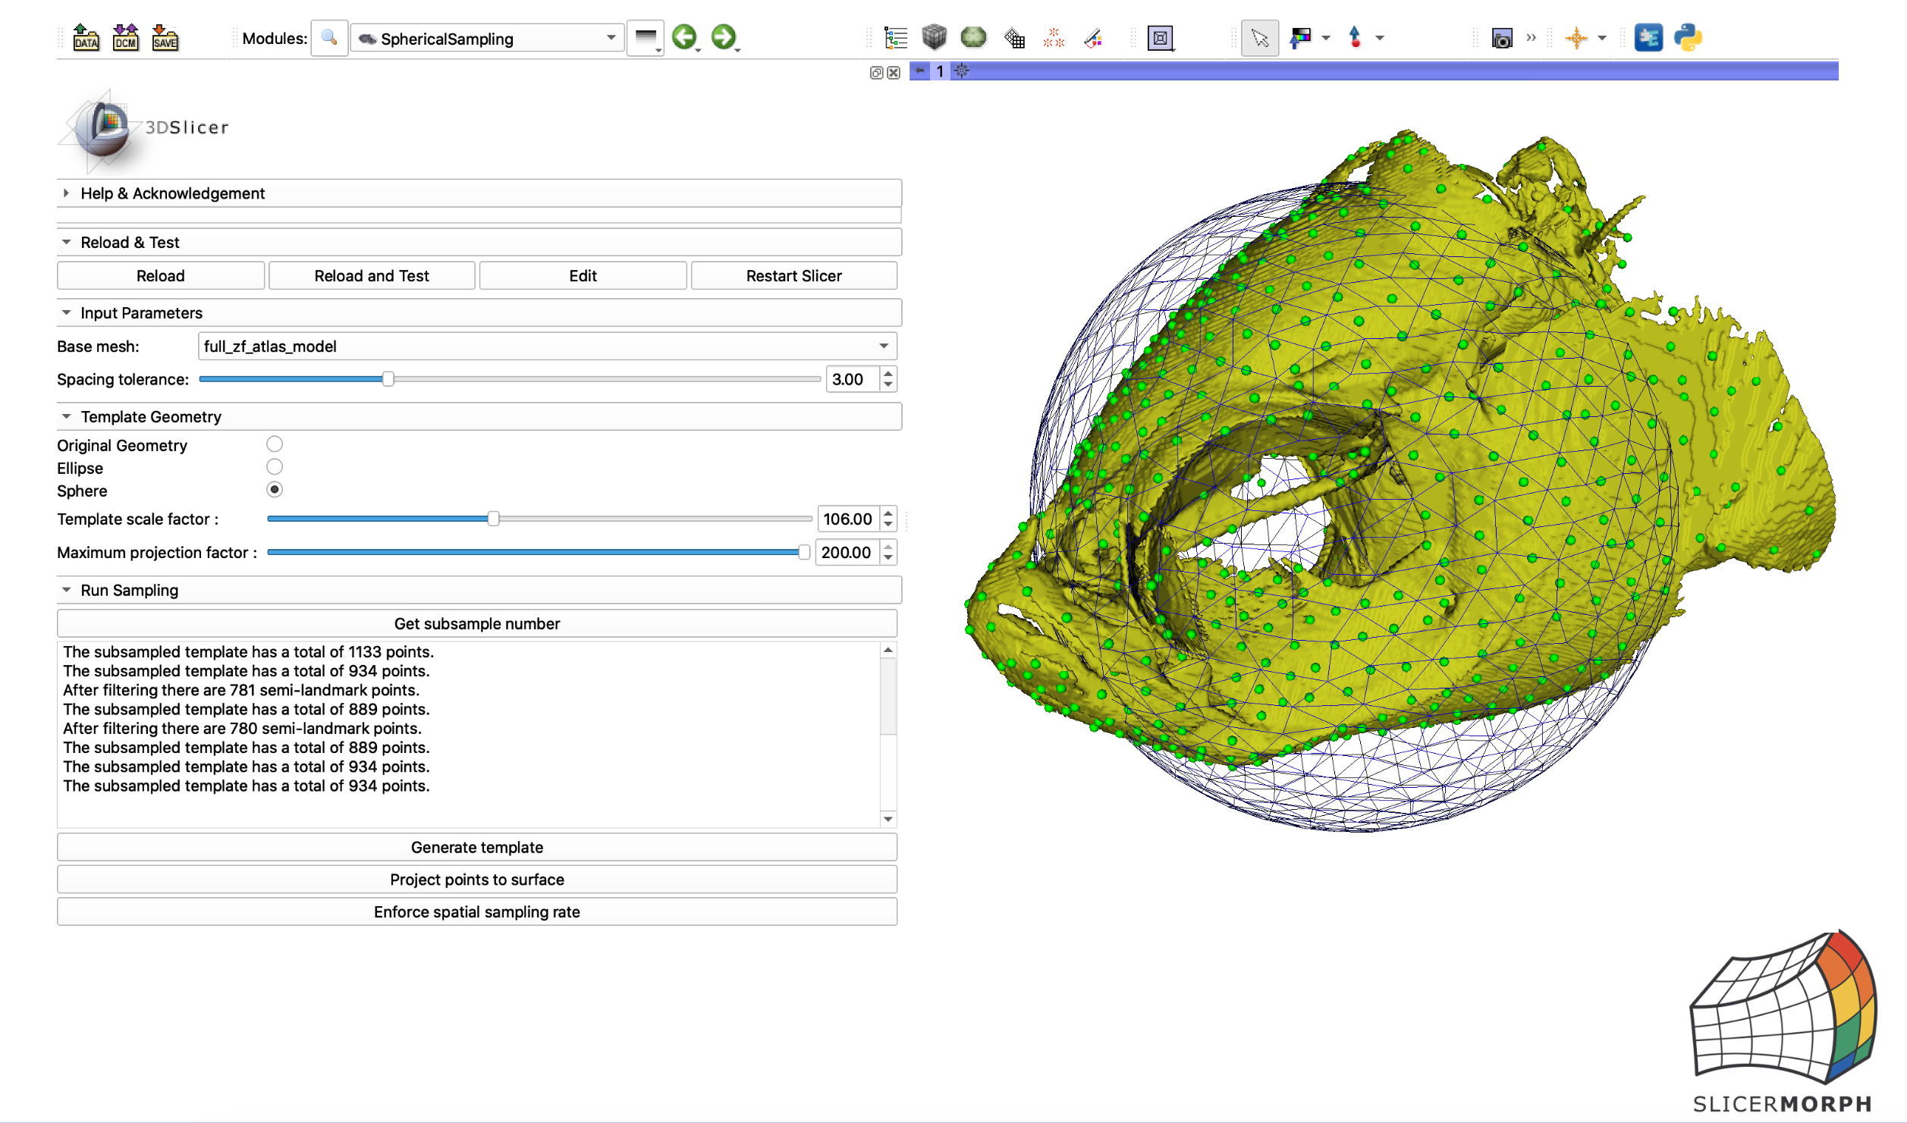
Pseudolandmarks

Slide 14
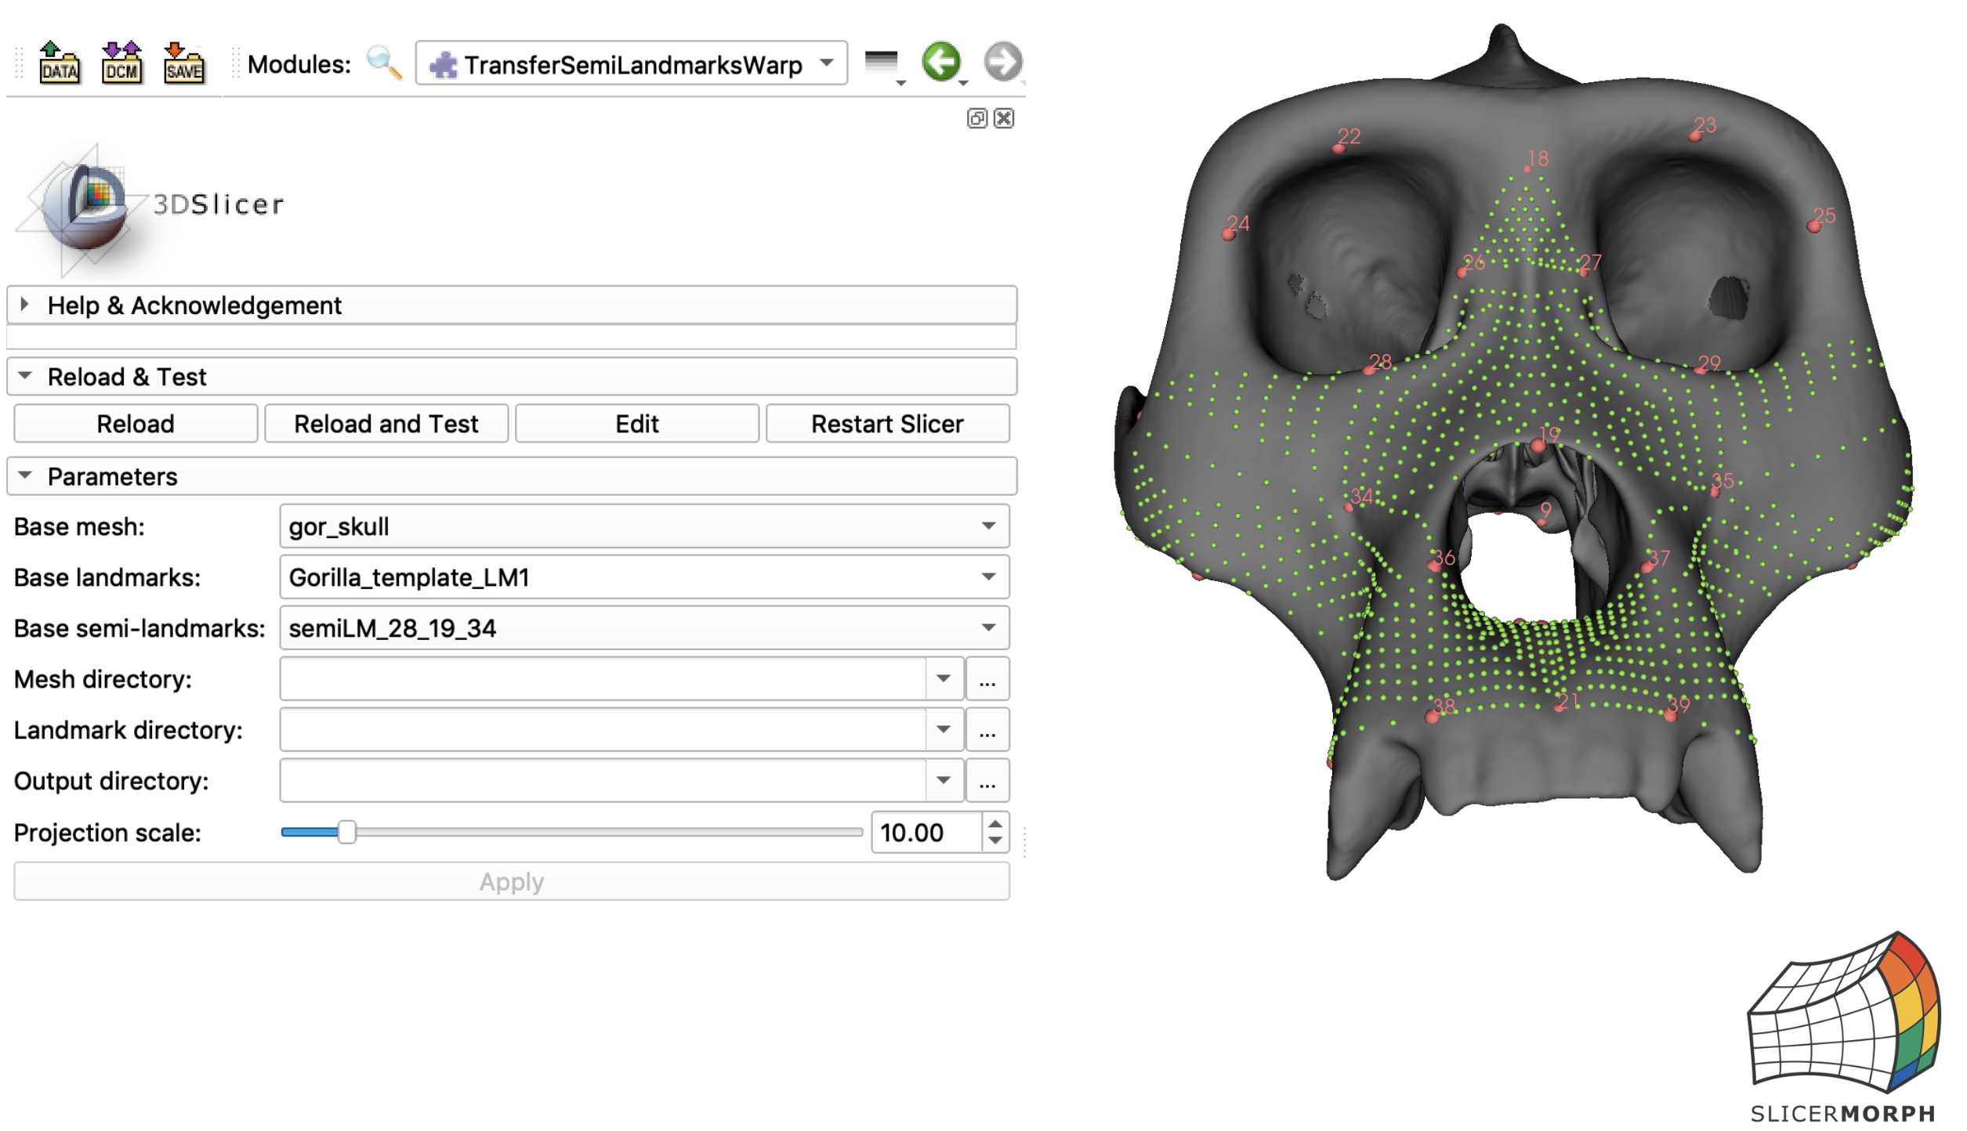
Transferring Patch Landmarks

Slide 15
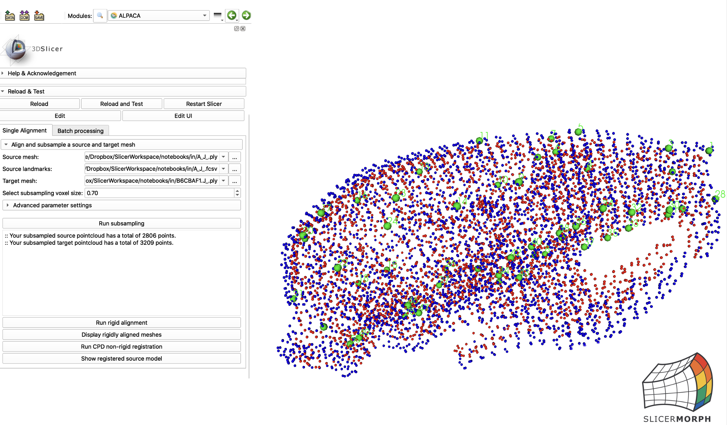
Transferring Landmarks - ALPACA

